Slide 1
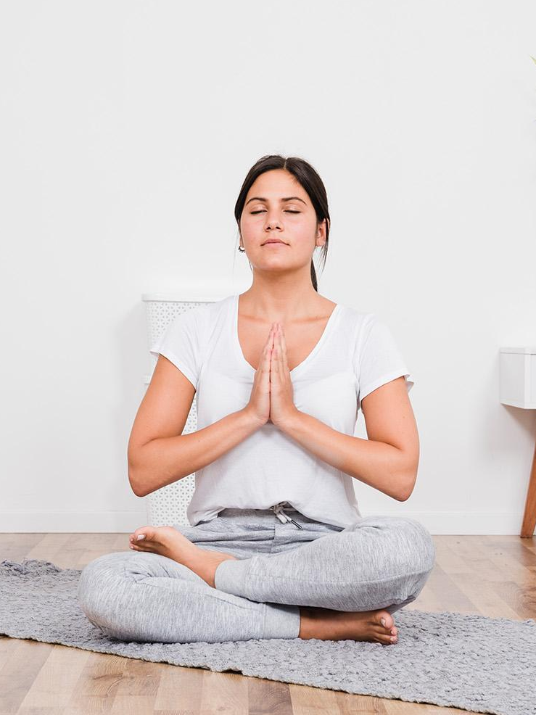
Meditation a Daily Routine
Prepared By
18DCS007
RUDRA BARAD

Slide 2

What Is The End Goal of Meditation
There is no end to meditation. It gets deeper and deeper. But the goal is to connect to the god without any agenda

Slide 3

How to start Practice it
It is recommended to do a thing for the short amount to make it easy.
It's really important to go on a short retreat like a one day or a one week retreat and just go deep

Slide 4
What’s the biggest mistake we make ?

Slide 5
What’s the Problem ?
I can’t see anything
Oh god !
This is so difficult
I don't understand anything

Slide 6
Anonymous
The goal of meditation is inner cleansing and healing so you can truly see yourself…

Slide 7
Thank You!

